Slide 1

Unlocking Educational Potential Through Integrated Dashboards
A Guide to Ellucian’s Experience Solutions

Slide 2
About Us
Danny Ramos
Director, Application Development & Administration
Florida SouthWestern State College
13 years
Ted Tramonte
Assistant Director, Web Applications
Florida SouthWestern State College
7 years
Colton Herschberger
Web Developer
Eckerd College
2 years

Slide 3
Topics
Overview of Ellucian Experience
FSW's implementation process and challenges
Baseline and custom integrations with other services
Our experience with Experience
Deep dive into custom integrations

Slide 4
Experience Overview
Dashboard
Discover
Announcements
Calendar
Integrations

Slide 5
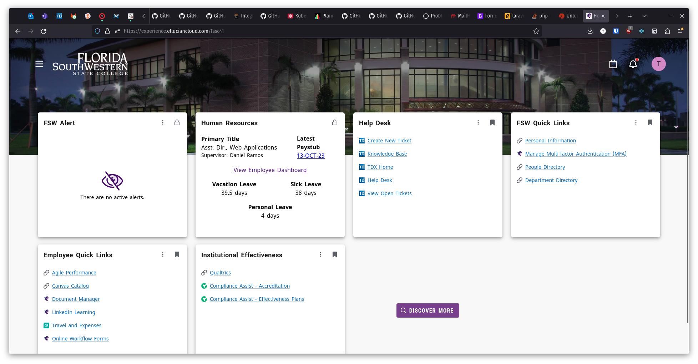
Dashboard
User customizable grid of Cards
  Cards can be locked to the dashboard (lock icon)
    Cannot be re-ordered
  Cards can be shown by default (bookmark icon)
    Can be un-bookmarked by users
  Users can bookmark cards not shown by default
Responsive design - mobile friendly
Directs users to Discover page

Slide 6
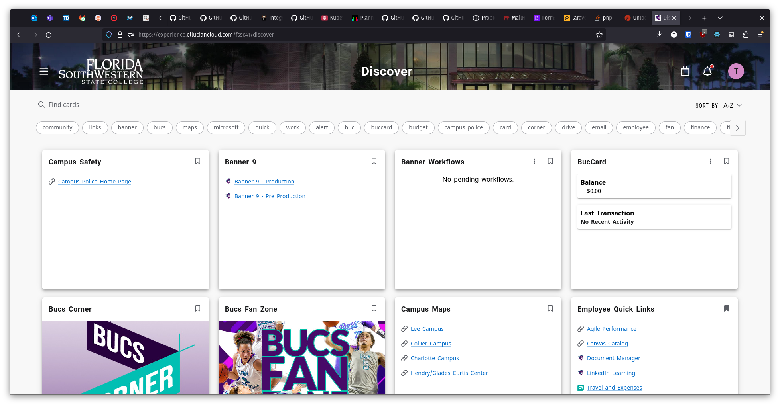
Discover
Shows all cards a user can access
Cards have tags which can be filtered
Cards can be bookmarked or un-bookmarked

Slide 7
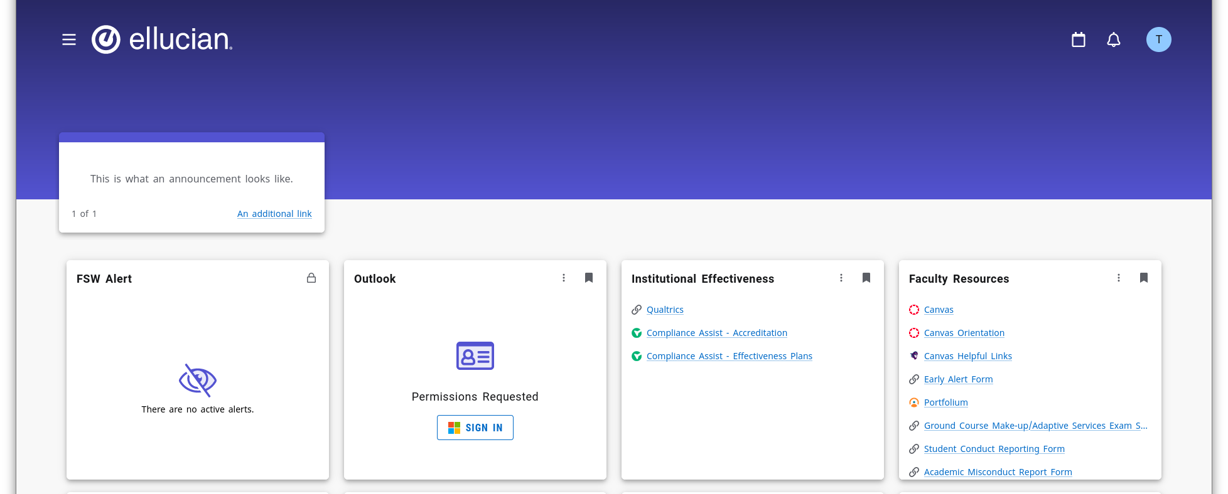
Announcements
What they look like

Slide 8
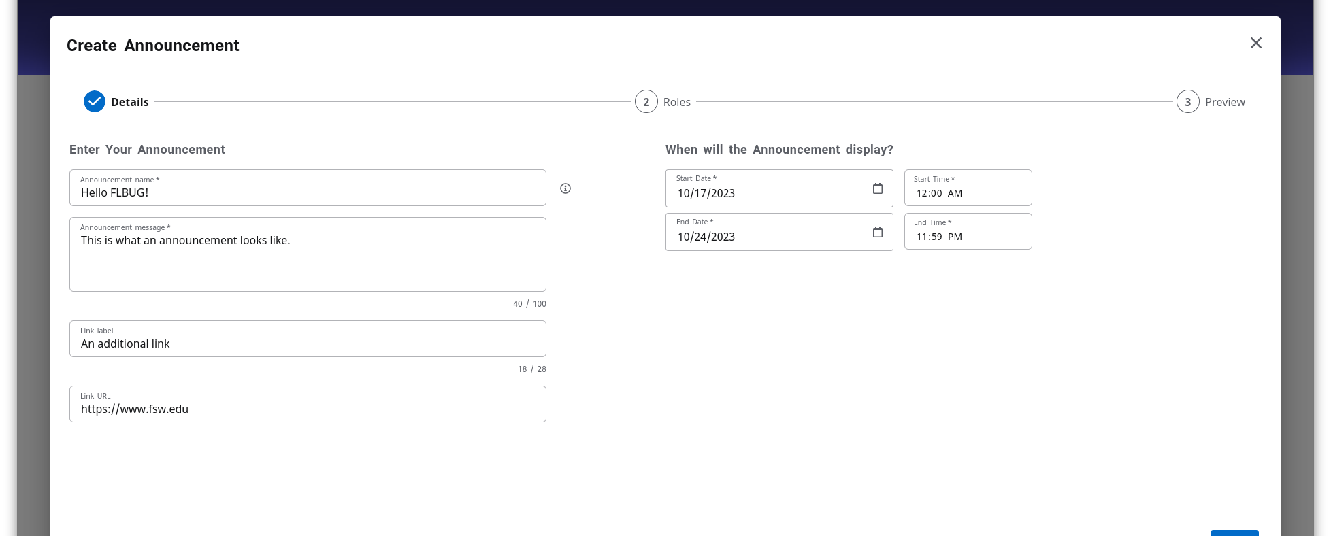
Announcements
Creation options

Slide 9
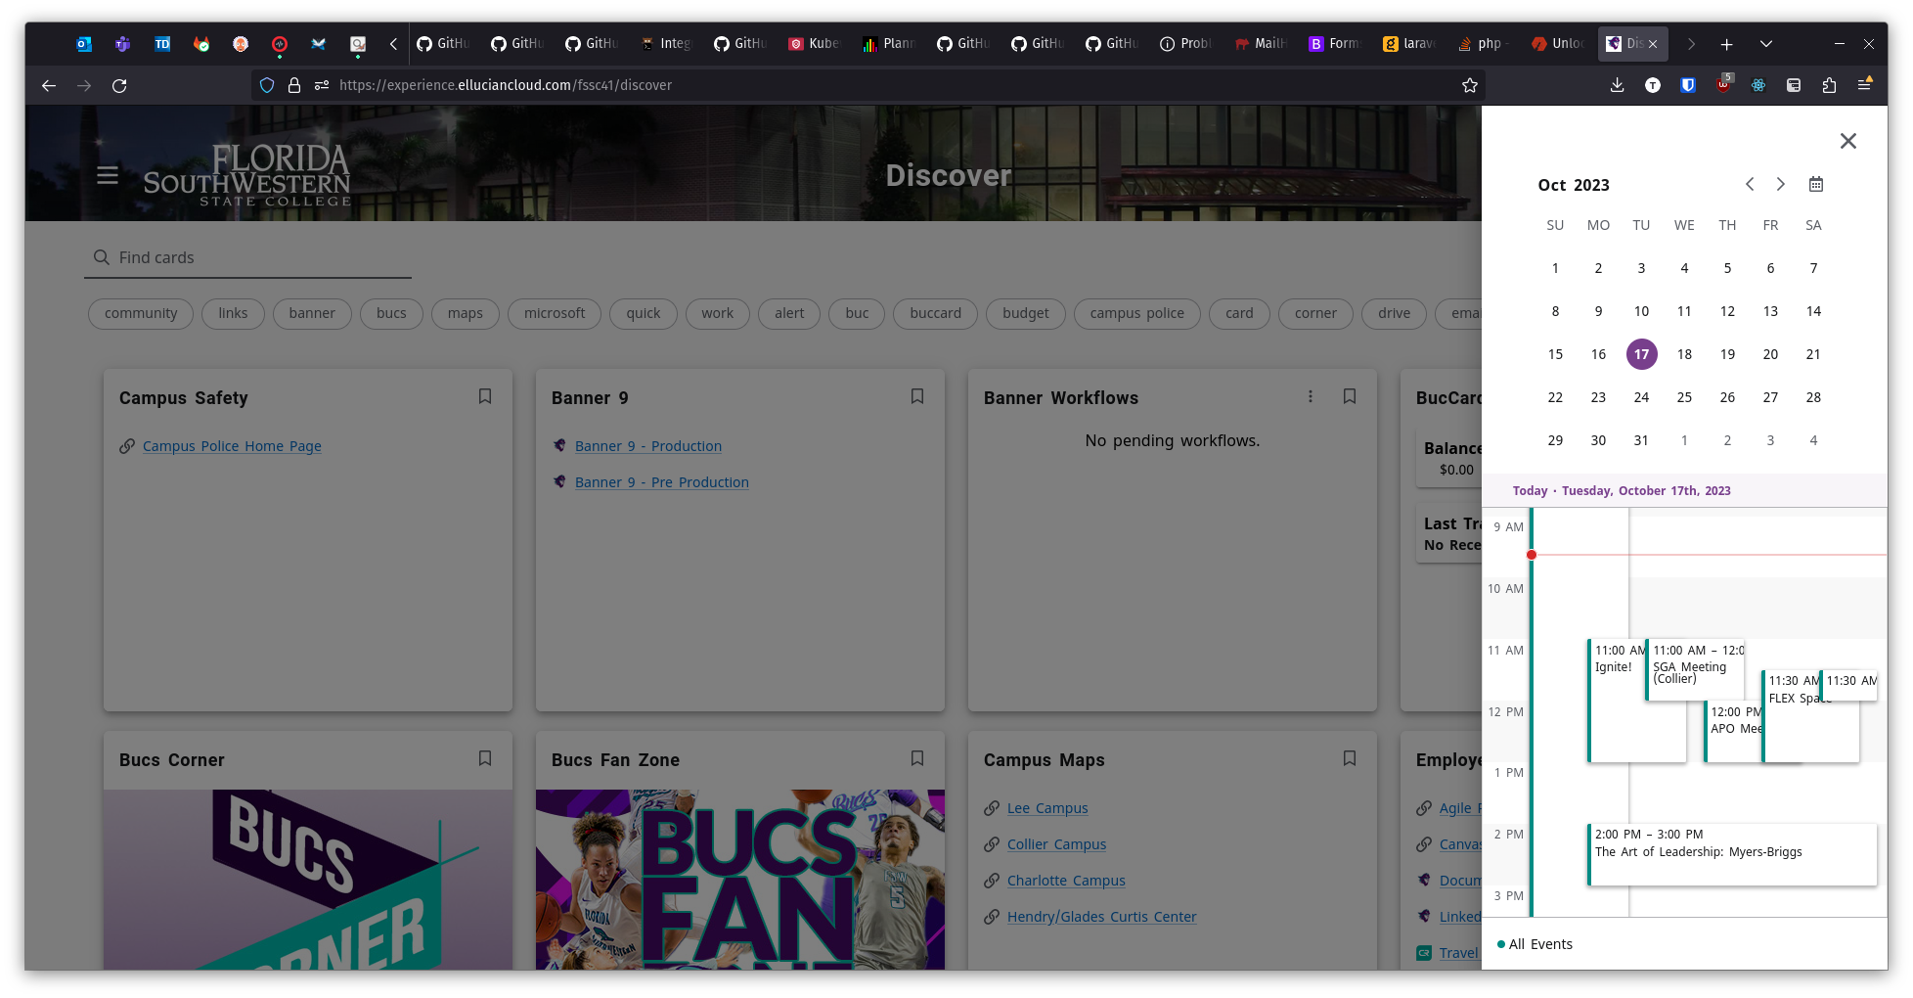
Calendar
Up to 5 separate event feeds
Accepts iCal data format
  Can read from an uploaded file or a URL
Also provides a "list" view for a simple list of events

Slide 10
Integrations
Provides baseline integrations with many Ellucian products
  New integrations are being developed
Custom integrations are built using standard web development tools

Slide 11
Implementation Process
Plan and Challenges

Slide 12
Implementation Plan
"Startup" approach
  Ship a minimum viable product as soon as possible
  Plan for and aggressively develop more cards after (soft) launch
Tiered rollout
  First provide access information to members of IT to beta test
  "Soft launch" / "open beta" / "open pilot"
    Run in parallel with Luminis Portal
    Loudly advertise the cutoff date for Lumins Portal
  Full launch
    Redirect previous domain to Experience
    Pull the plug

Slide 13
Challenges
Card categories
  Can't create new categories or delete existing ones
  Can be renamed
Single Sign-On
  Experience Roles are set through the SSO provider
    Keycloak requires a little more effort
Google and Microsoft cards
  Not baseline, provided in a community repository on GitHub
  Can't sign into one card with two different accounts (e.g. staff and student mailboxes)
No cloning between environments
  Reduces the usefulness of the Test environment
  "Just do it in Prod"

Slide 14
Integrations
Baseline and Custom

Slide 15
Baseline Integrations
Advise
Ellucian Workflow
Student At A Glance Information – Classes, Schedules, Advisor Information
Maestro
  Closed Beta

Slide 16
Custom Integrations
Human Resources
Student Status
Student Financials
Canvas

Slide 17
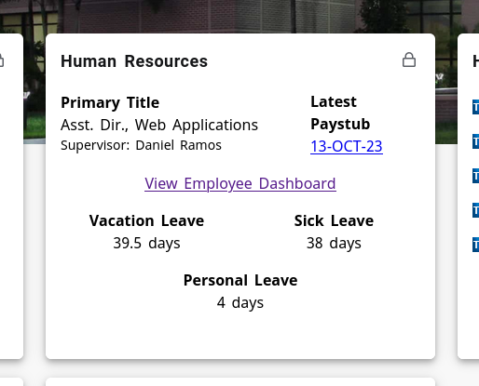
Human Resources

Slide 18
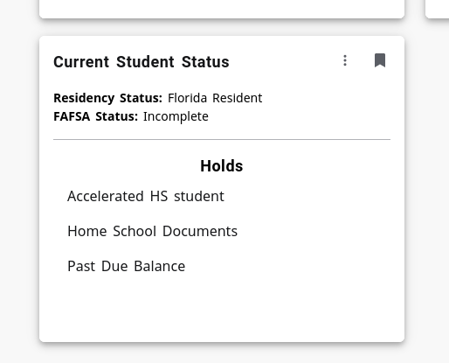
Student Status

Slide 19
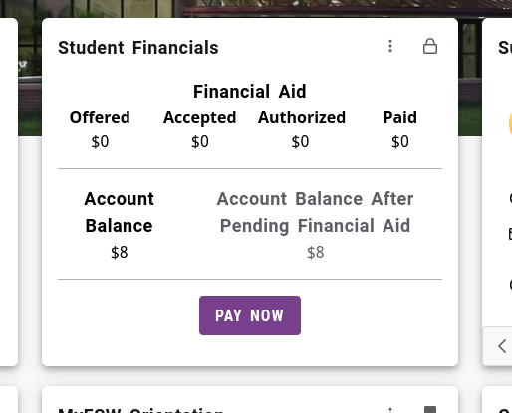
Student Financials

Slide 20
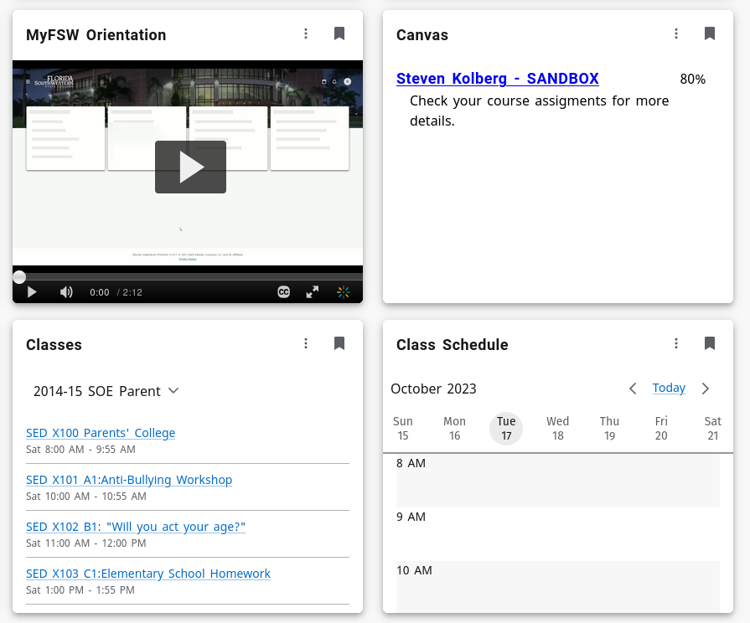
Canvas

Slide 21
Our Experience Experience
Findings and recommended best practices

Slide 22
Developer Feedback
Ana Tarasenko
"[The] documentation was a little bit confusing, but other than that, it was relatively easy"
Dabraham Martinez
"[Experience] can be a little inconvenient for first set up and deployment"
"[It's] very open ended so we can pretty much build what we want"
"[Development is] not bad now that we have a template and a few cards to cannibalize from"
Joey Fasanelli
"[Experience was] easy to work with after initial setup and configuration"

Slide 23
Recommended Best Practices
Create an Experience Extension repository template with the quirks of your environment configured
  GitLab CI/CD configuration, useful JavaScript libraries, card/page skeletons to duplicate and start work, etc.
Create an orientation video targeted towards your user population
  Set it as a default card for all roles, users can remove when oriented
Develop a plan for what cards are a must have, should see, and user preference
  Cards have three tiers: Lock (always displayed), Display (bookmarked by default), and Default (available in Discover)
  Consider user roles as well
    Employees always see Human Resources card, Students always see Student Financials, Student/Employees will always see both

Slide 24
Things We Like
Provided theme styling is quite pleasing (but beauty is in the eye of the beholder)
Role-based cards are powerful for preventing information overload
Supporting technologies used are modern
  Modular
  Mobile friendly by default
  Uses current developer tools your team is likely familiar with
API-based deployments
  Extensions set up to deploy to Test on every code commit, deploy to Prod by pushing a Git tag

Slide 25
Things We Don't Like
Inability to use custom domain
  Can redirect to Experience instance, but it isn't quite the same
No control over downtime
  Small or greener teams may see this as a positive
Provided HTML Card type does not inherit styling from the application
  Left with gross Web 1.0 styling out of the box
  Must duplicate Ellucian Experience styling for consistency
  May as well create a custom Card in an Extension
Cards crash when render function has an undefined variable, rather than allowing a graceful default
  This is Experience being "helpful" but frustrating when developing

Slide 26
Going Forward
Continue working towards full feature parity with legacy Luminis Portal
1
Leverage the Announcement feature
2
Utilize our Maestro Beta access
3
Student tasks

Slide 27

Questions or comments so far?

